Slide 1




NEXT GEN EMPLOYABILITY PROGRAM
Creating a future-ready workforce
Team Members
College Name
Student Name :B.G.EzhilAparna
Student ID : au412321104010
Sri Ramanujar Engineering college

Slide 2

CAPSTONE PROJECT SHOWCASE
Project Title
MUSIC WEB APPLICATION USING DJANGO FRAMEWORK
Abstract | Problem Statement | Project Overview | Proposed Solution | Technology Used | Modelling & Results | Conclusion

Slide 3
Abstract
Mewsick: Redefining Music Streaming with Django
Mewsick is a dynamic web music player crafted with Django Framework, offering an immersive and intuitive listening experience. Join us as we uncover the innovative techniques and special features that set Mewsick apart. From personalized playlists to seamless cross-device playback, discover how Mewsick is reshaping the future of music streaming.
Source :

Slide 4
Problem Statement
User Registration Page
Authentication
Database Integration
Linking other pages
In django the external css import is different
Source :

Slide 5
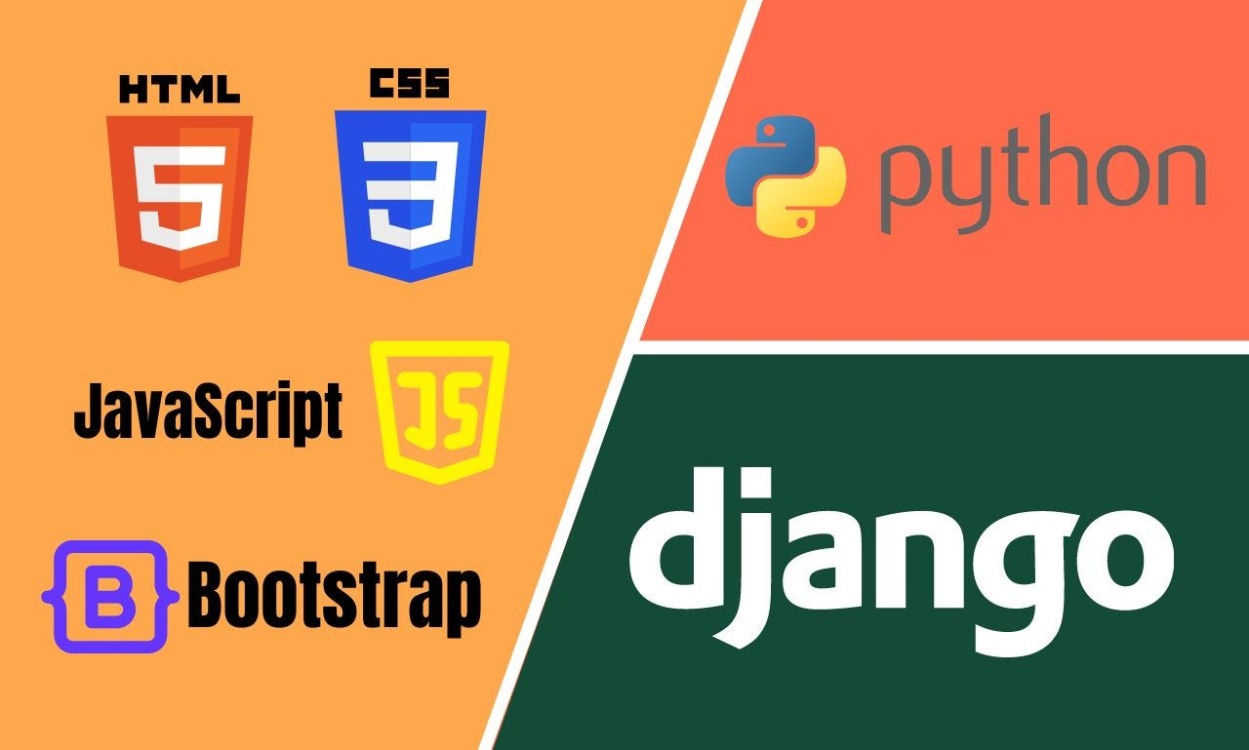
Project Overview
Front end
Back end
The front end was developed using HTML to define the structure of the website, CSS for styling elements, and Bootstrap for utilizing prebuilt styles. On the other hand, the back end was implemented using Django, which serves as a framework for seamlessly integrating the front end and back end components, all powered by Python.
Source :

Slide 6
Proposed Solution
.
Django helped to store the data
Now we can authenticate
Django integrated database(sqlite3)
get help from youtube
used internal css but now i know how to add external css
Source :

Slide 7


Technology Used
Front-end
Back-end
Source :

Slide 8
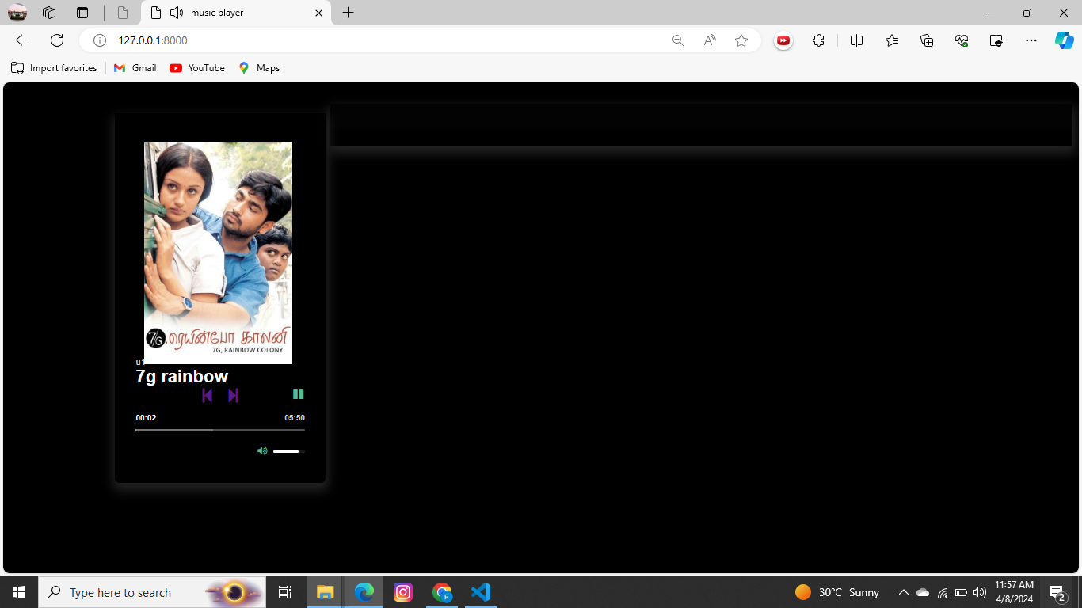
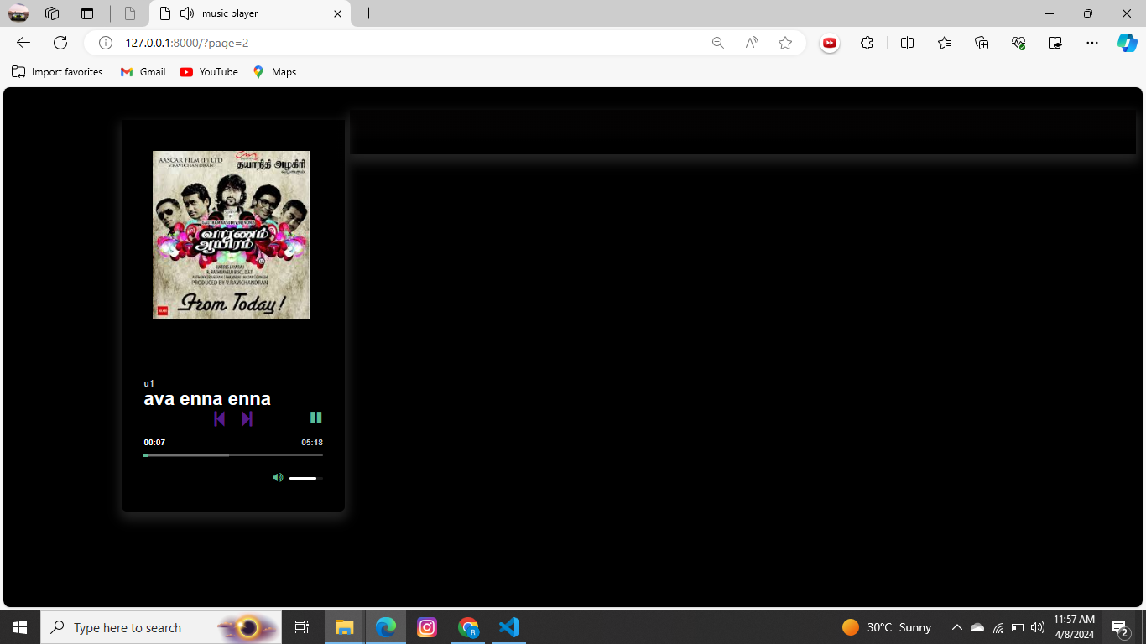
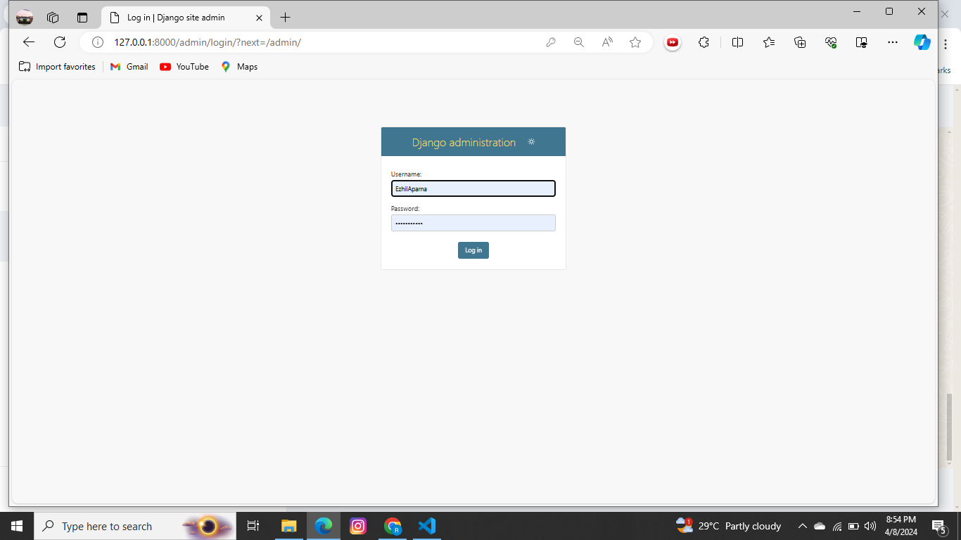
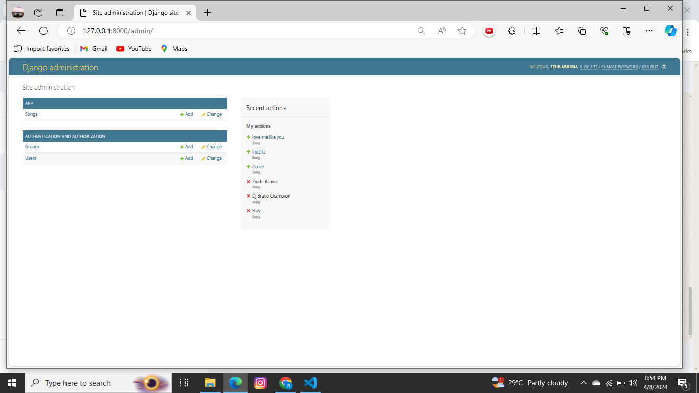
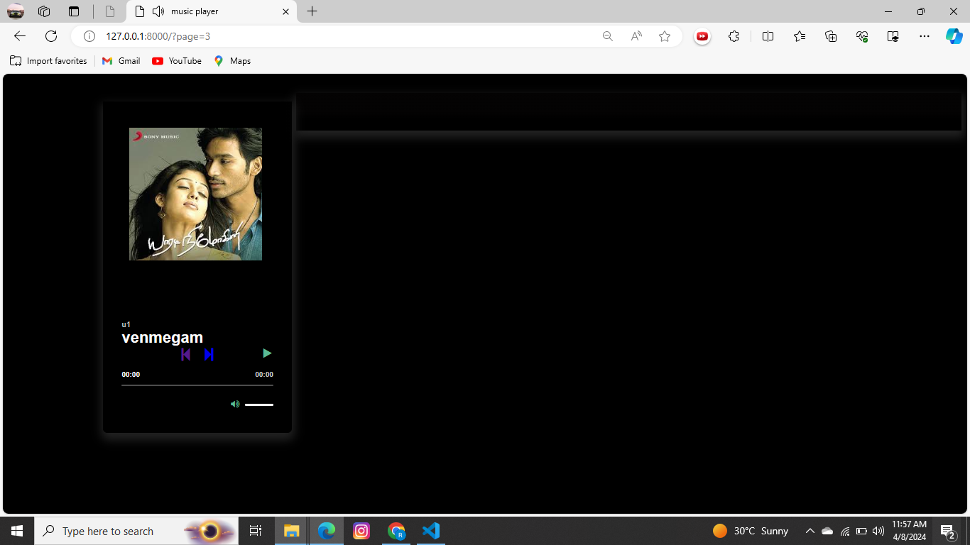
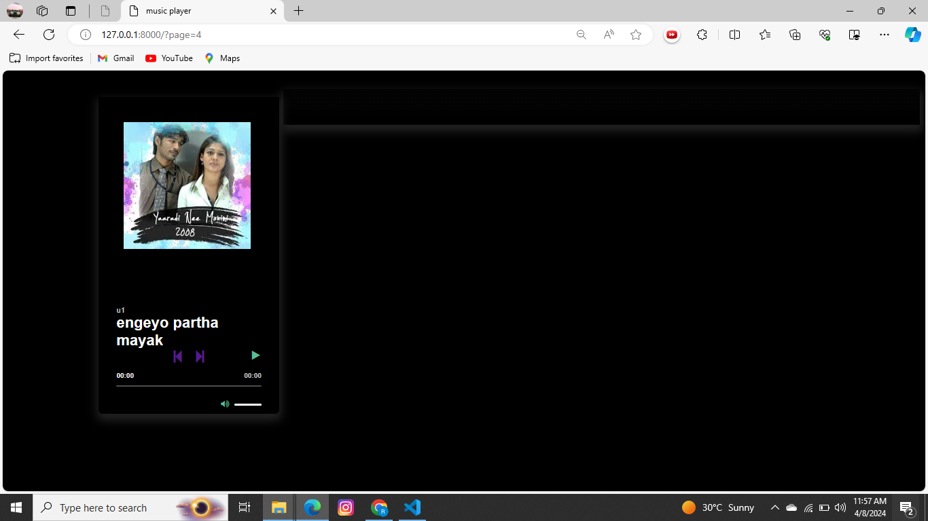
Modelling & Results
The signup and login pages are functioning successfully, and the data entered by users is being stored in the database accurately.
The songs are playing properly, indicating successful implementation.
Source :

Slide 9



Homepage

Slide 10
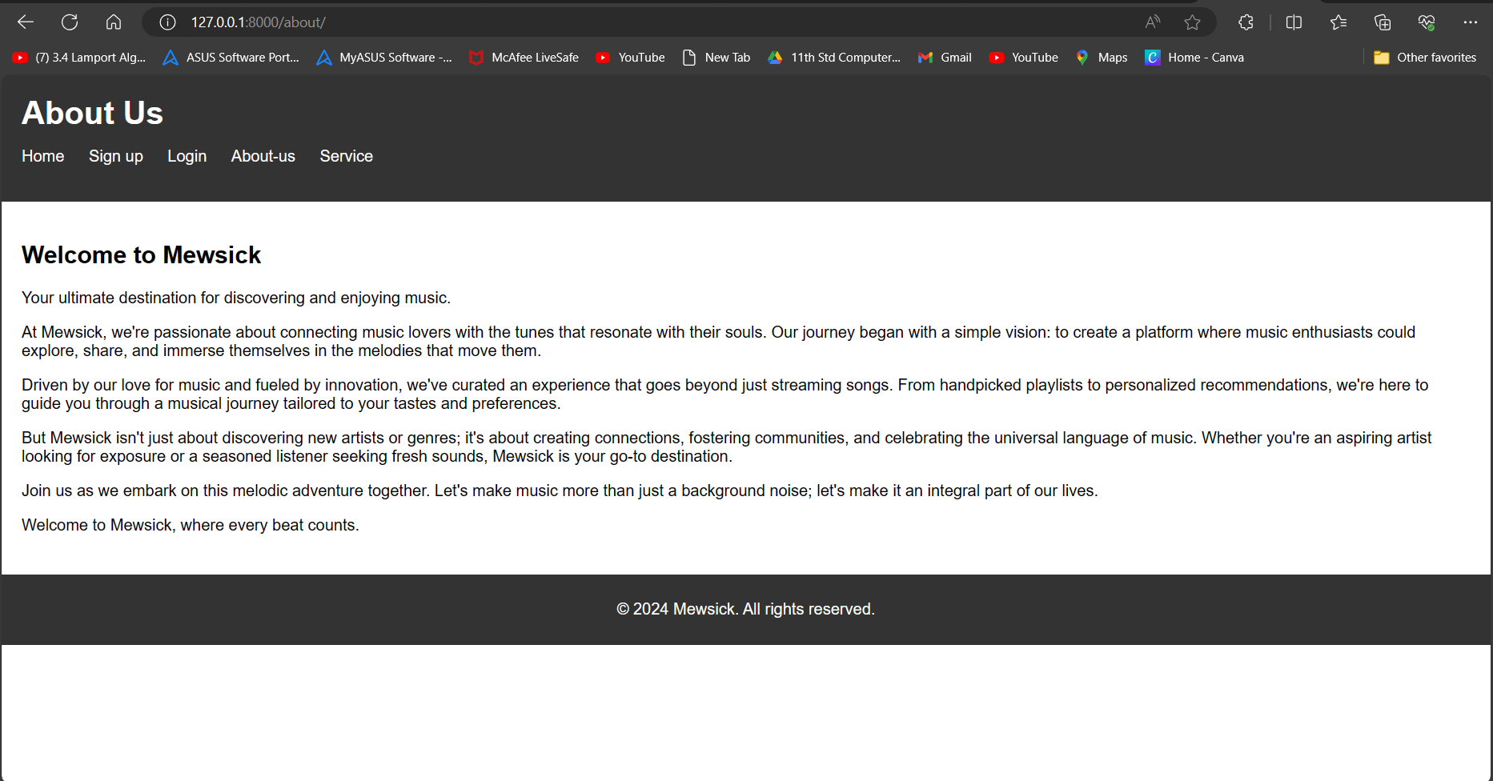
About-Us-Page

Slide 11
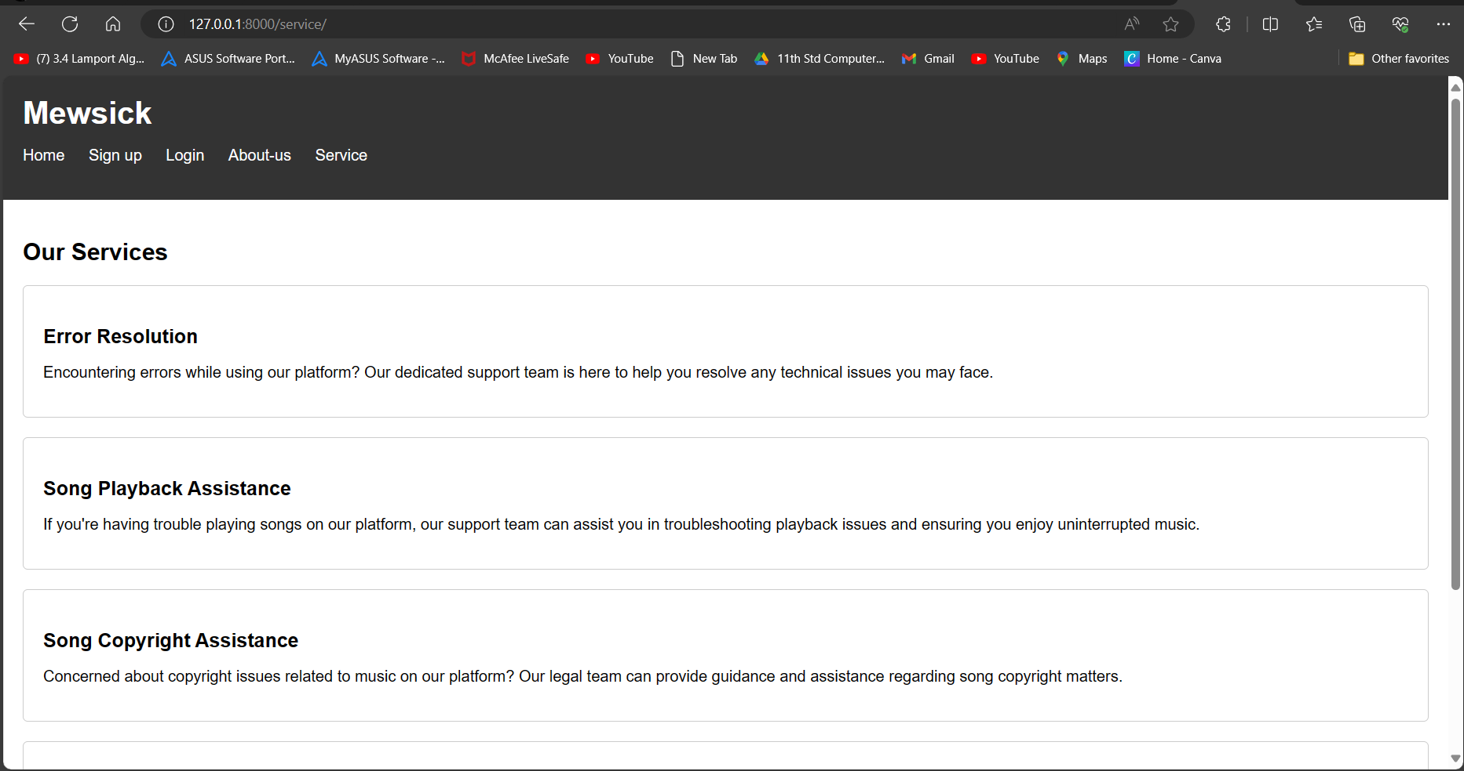
Service-Page

Slide 12
Future Enhancements:
Enhanced Favorite Songs Feature
Real-time Listening Together Feature
Friend Networking and Social Integration
Premium Subscription Model
Expanded Music Library
Personalized Recommendations and Discovery
Community Engagement and User Interaction
Cross-Platform Compatibility

Slide 13
Conclusion
Stay connected with Mewsick to discover and enjoy sick tunes.
Peace out!
Source :

Slide 14
Thank You!
Notes:
Thank You !!

